Slide 1


DESIGN 1
Lesson 2: Guided Build - Structuring a Page
Ms. Abboud · Grade 9 - Design 1 · Term 1, Week 2

Slide 2
Learning Objectives
WALT - We Are Learning To
WILF - What I'm Looking For
Build a correctly structured HTML document using html, head, title, and body tags.
Apply teacher-modeled checkpoints to confirm each part is in place before moving on.
Document includes all 5 core tags in the correct nested order.
Page renders in the browser with no visible errors.

Slide 3
Academic Vocabulary
Opening Tag
Closing Tag
The first half of an element, written as <tagname>, that marks where it begins.
The second half of an element, written as </tagname> with a forward slash, that marks where it ends.
Case Sensitivity
When uppercase and lowercase letters are treated as different characters. HTML tags should stay consistently lowercase to avoid errors.

Slide 4
Frayer Model: Case Sensitivity
DEFINITION
CHARACTERISTICS
When uppercase and lowercase letters are treated as different characters. HTML tags and attributes should stay consistently lowercase to avoid errors.
Uppercase and lowercase treated differently; HTML tags are conventionally lowercase.
CASE SENSITIVITY
EXAMPLES
NON-EXAMPLES
class vs CLASS treated as different in some contexts.
Human reading, where 'Hello' and 'HELLO' mean the same thing.

Slide 5
National Identity Integration
UAE Digital Economy: every clearly structured webpage you build is a small-scale example of the digital infrastructure the UAE is investing in as it grows a knowledge-based economy. The same logical organization you practice today, breaking a page into head and body, nesting elements correctly, is exactly what powers the government services, banking apps, and businesses that make up the UAE's digital economy.

Slide 6
STARTER
Quick matching activity
Match each tag name to its purpose.
Hook · Engage & Ask
5 - 10 minutes

Slide 7
LESSON CORE
I Do: Teacher Models
Teacher models building a document structure one step at a time, pausing after each line for you to replicate it.
Gradual Release of Responsibility
30 - 40 minutes
Example: target structure (yours should match this)
<!DOCTYPE html>
<html>
<head>
<title>My Structured Page</title>
</head>
<body>
<h1>Welcome</h1>
<p>This paragraph is nested correctly inside the body.</p>
</body>
</html>
1 / 3

Slide 8
LESSON CORE
We Do: Checkpoints
Checkpoint 1: confirm DOCTYPE + html tags are in place.
Checkpoint 2: confirm head + title are in place.
Checkpoint 3: confirm body opens and closes correctly.
Add a heading and a paragraph inside body to test your understanding of nesting.
Gradual Release of Responsibility
30 - 40 minutes
2 / 3

Slide 9
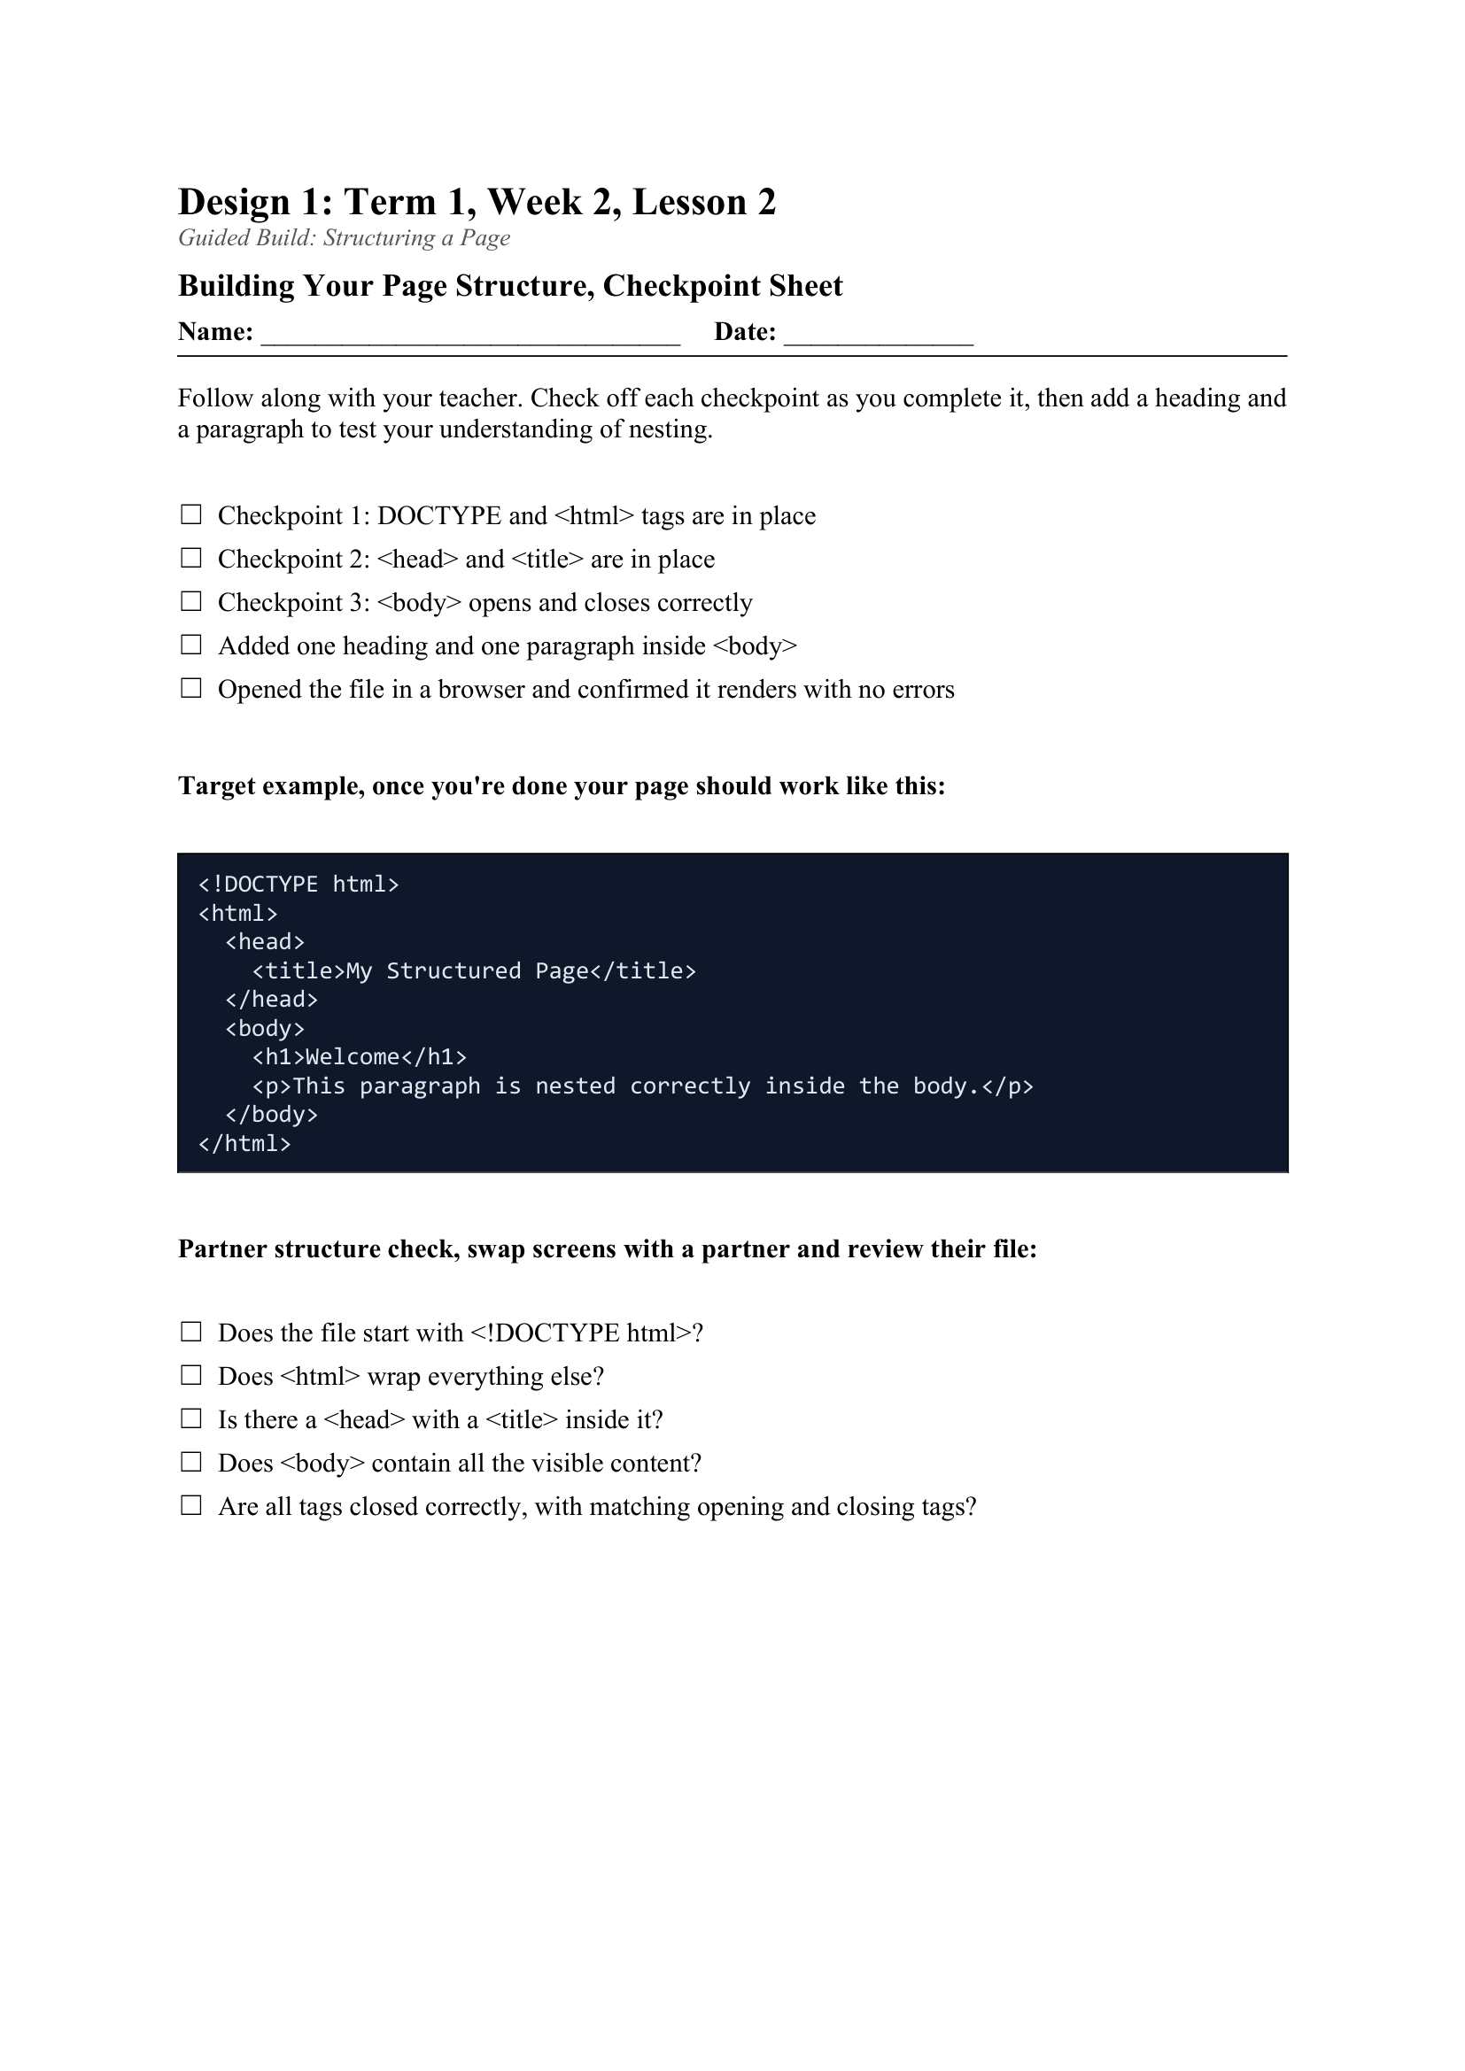
LESSON CORE
You Do: Build & Check
Build the shell of a brand-new HTML page from scratch following the three checkpoints, then open it in a browser.
Watch out for: unclosed tags, mismatched tags, and case sensitivity.
Activity: Building Your Page Structure, Checkpoint Sheet
Gradual Release of Responsibility
30 - 40 minutes
3 / 3

Slide 10
CLOSURE
Partner check
Swap screens and use a quick structure checklist to review each other's file.
Transition & Extend
5 - 10 minutes

